Slide 1

SKB DONGLE _ ID Proposal _ V1.0
FG GROUP Industrial design department
© 2021 FOXCONN. Proprietary and Confidential.

Slide 2
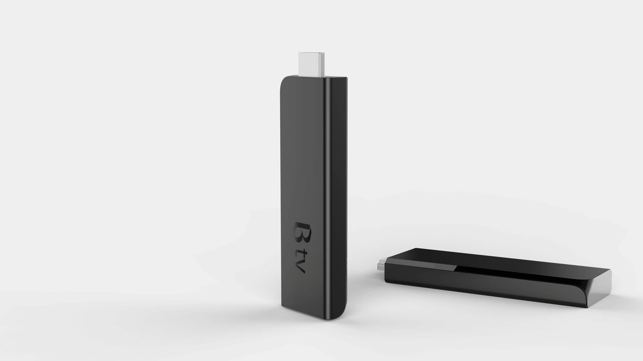
Proposal E

Slide 3
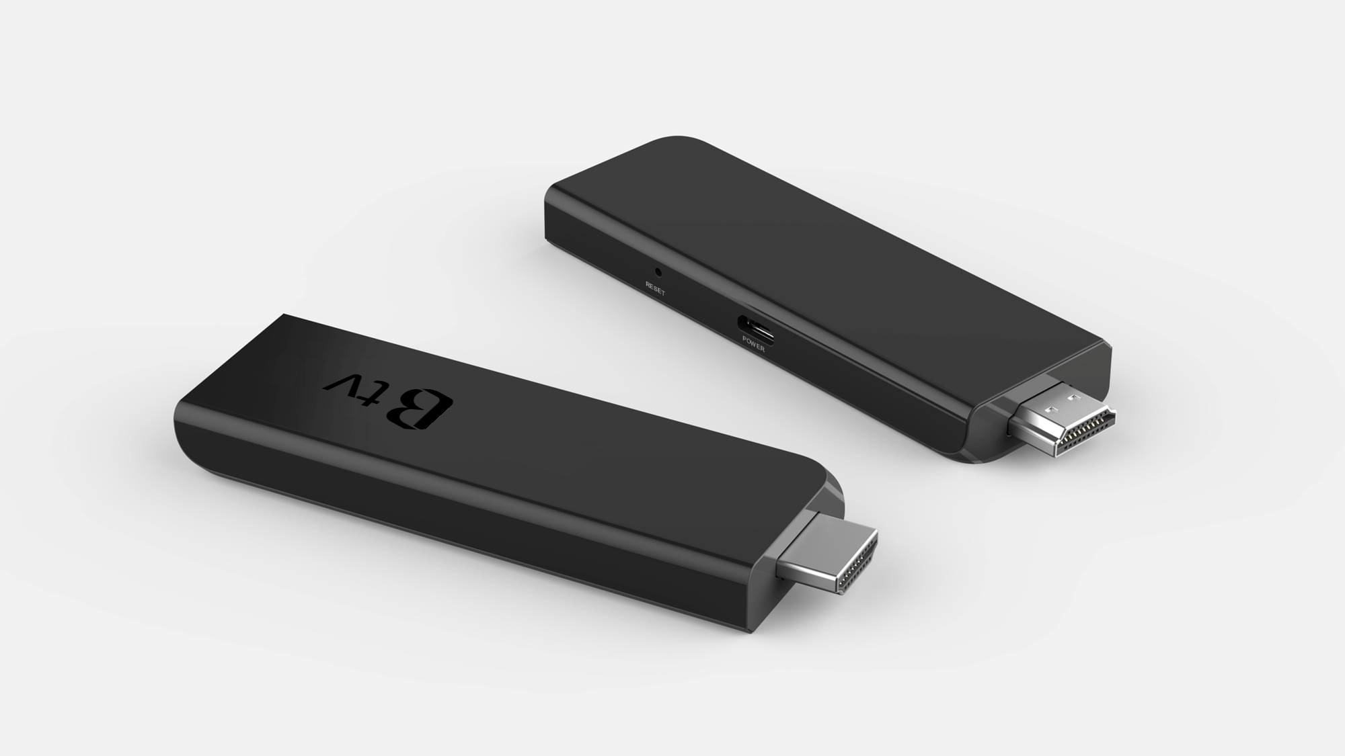
Perspective view

Slide 4
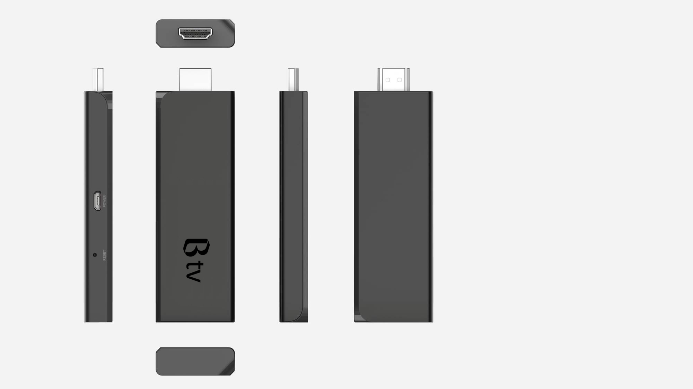
Proposal E
04
C . M . F
01a
01a. Front cover
C : Black / M : Plastic / F : Polish (SPI A2)
LOGO
C : UV-Translucent ink/ Printing
01b
01b. Front cover
C : Black / M: Plastic / F : Texture (MT11010B)
03
02a. Back Cover
C : Black / M: Plastic / F : Polish (SPI A2)
02b. Back cover
C : Black / M: Plastic / F : Texture (MT11010B)
02a
03. USB
02b
04. HDMI
Dimensions :
93.5(W) X 32 (D) X 11.6 (H) mm

